Slide 1


Spectrum Prediction via Graph Structure Learning
Dong Yang

Slide 2
Outline
Background
Motivation
Proposed method
Simulation results
Next step and future work
1

Slide 3

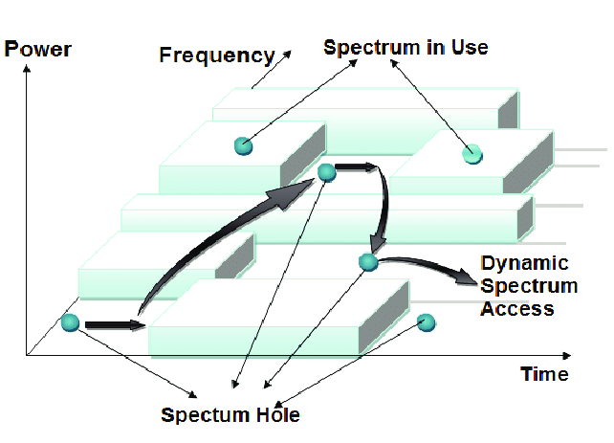
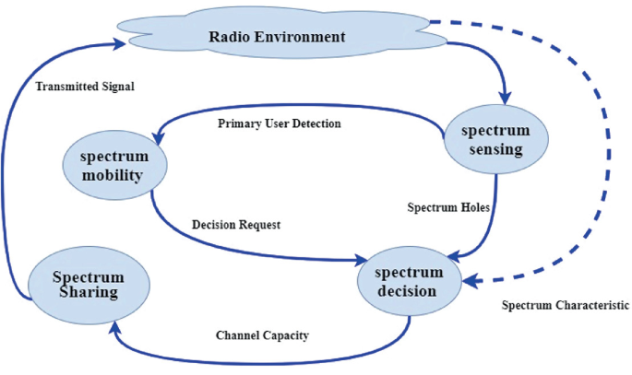
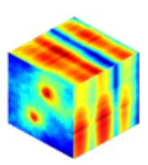
Background
Dynamic spectrum access
Cognitive radio (CR) users can opportunistically access unoccupied spectrum bands.
freq./time domain
spectrum holes in freq. and time domains
cognition cycle
Spectrum map
Enabling techniques for spectrum awareness in DSA:
Spectrum sensing (Frequency domain)
Spectrum prediction (Frequency + time domains)
Spectrum cartography (Frequency + time + spatial domains)
These techniques enable CR to detect the dynamic occupancy of primary users in the target spectrum pool and rapidly identify access opportunities.
2

Slide 4
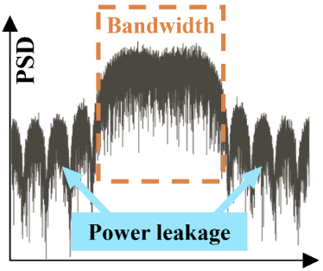
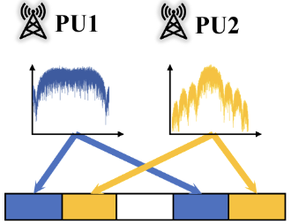
Background
Conventional spectrum prediction methods
Power leakage + Multi-band occupancy
Multi-band correlation
Power leakage
Multi-band occupancy
3

Slide 5
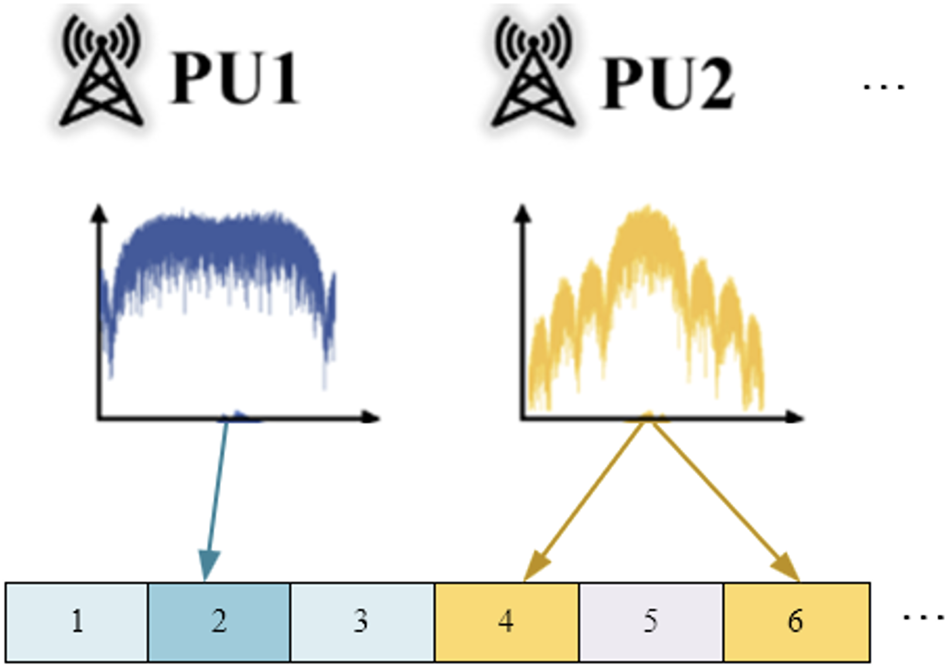

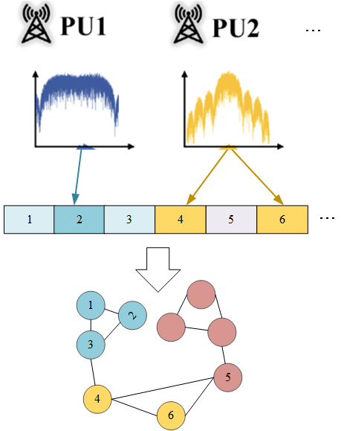
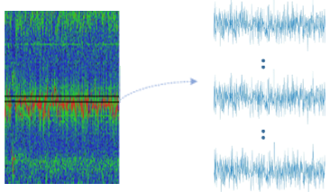

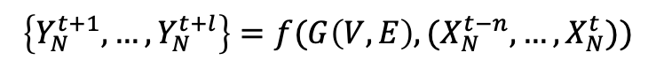
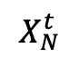
Background
Spectrum prediction methods based on Graph
Frequency band correlations problem:
A Graph is described by G = (V, E).
representing
V={ v₁, v₂, … , v_{N} }. A ∈ R^{N × N}
Temporal correlations problem:
Feature matrix is represented as:
X = {x₁, … , x_{N}} ∈ R^{N × T}
N
$X_{N}^{t}$ represents the PSD value of each frequency band at time t.
The problem of multi-band spectrum prediction:
T
$$X_{N}^{t}$$
$$\left\{Y_{N}^{t+1}, …,Y_{N}^{t+l}\right\}=f(G\left(V, E\right), (X_{N}^{t−n},…,X_{N}^{t}))$$
4

Slide 6
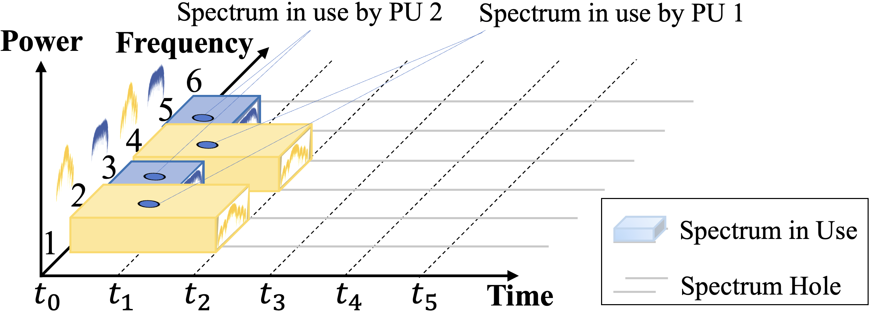
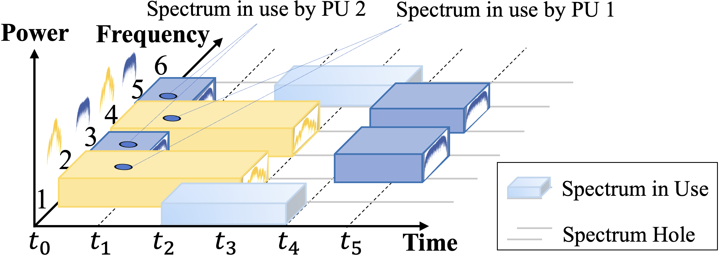
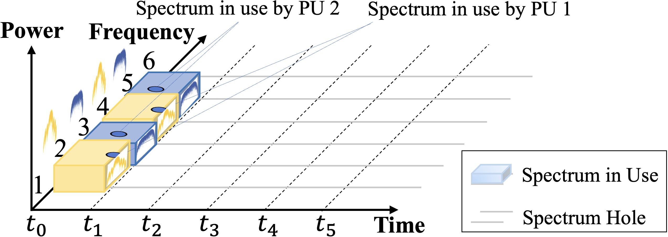
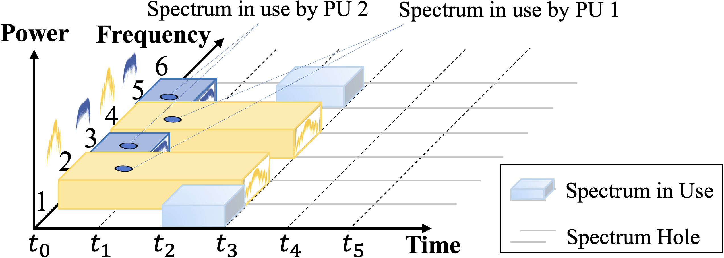
Motivation
Problems in traditional spectrum prediction methods based on Graph
Existing methods overlook the crucial multi-band correlations across different time periods on-the-fly.
How to capture the temporal dynamics across different bands
Multi-band correlations change over time
Motivation:
Change over time
Graph estimator
Learn graph dynamic on-the-fly
5

Slide 7
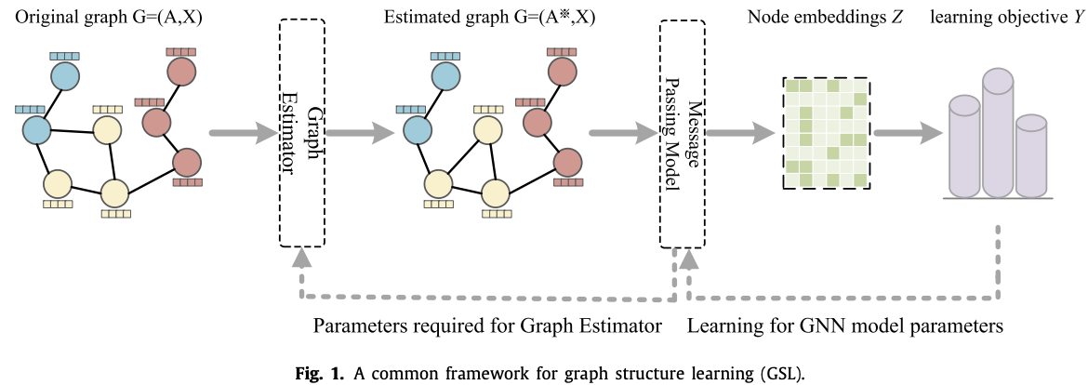


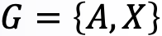
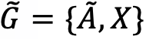
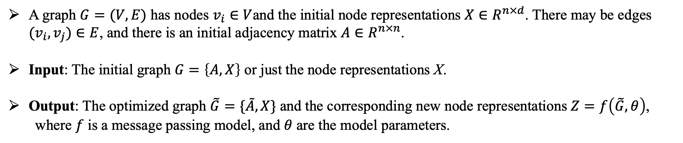
Graph Structure Learning
A graph $G=(V,E)$ has nodes $v_{i}∈V$and the initial node representations $X∈R^{n×d}$. There may be edges $(v_{i}, v_{j})∈E$, and there is an initial adjacency matrix $A∈R^{n×n}$.
Input: The initial graph $G=\left\{A,X\right\}$ or just the node representations X.
Output: The optimized graph $\tilde{G}=\{\tilde{A},X\}$ and the corresponding new node representations $Z=f\left(\tilde{G},θ\right)$,
where $f$ is a message passing model, and $θ$ are the model parameters.
6

Slide 8
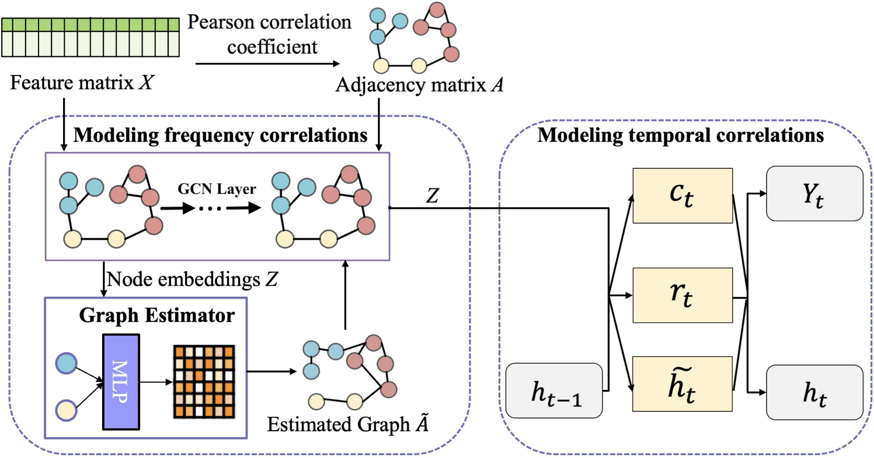
Overview
Graph structure representation: the adjacency matrix A expresses the multi-band correlations between bands.
Graph structure learning: Graph estimator re-estimates the adjacency matrix A.
Band frequency correlations: GCN extracts the correlations in the frequency domain.
Band temporal correlations: GRU extracts the temporal correlations of each band.
7

Slide 9
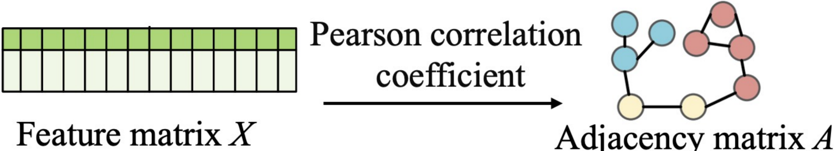
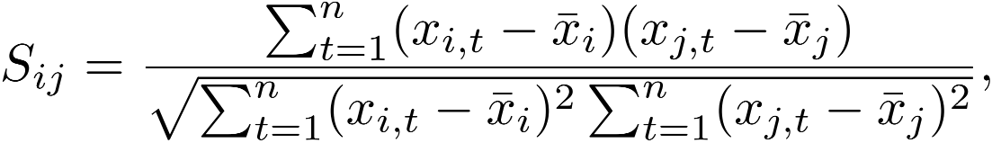
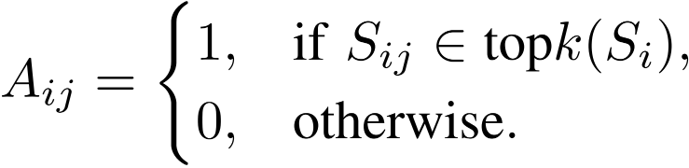
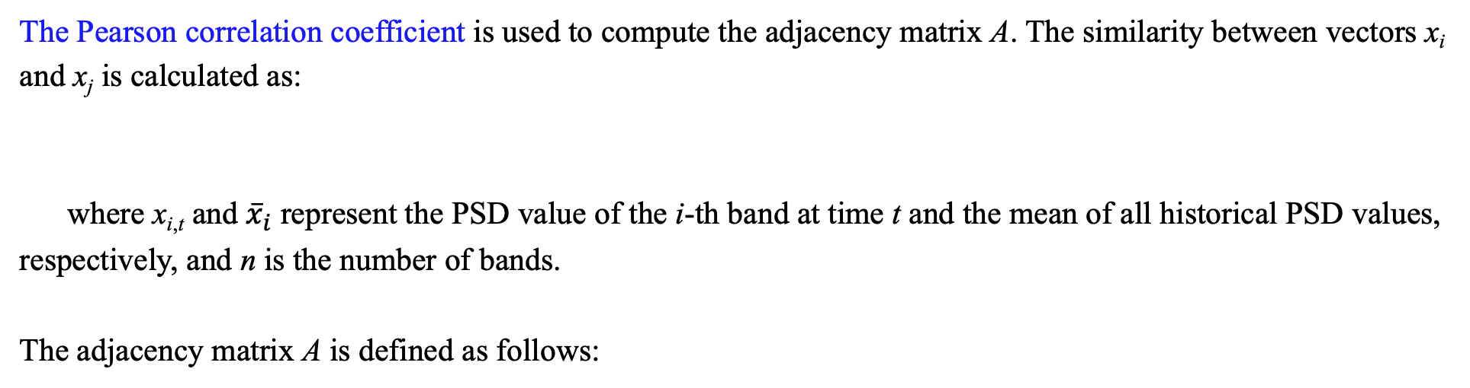
Graph structure representation
The Pearson correlation coefficient is used to compute the adjacency matrix A. The similarity between vectors x_{i} and x_{j} is calculated as:
where x_{i,t} and ${\overline{x}}_{i}$ represent the PSD value of the i-th band at time t and the mean of all historical PSD values, respectively, and n is the number of bands.
The adjacency matrix A is defined as follows:
8

Slide 10
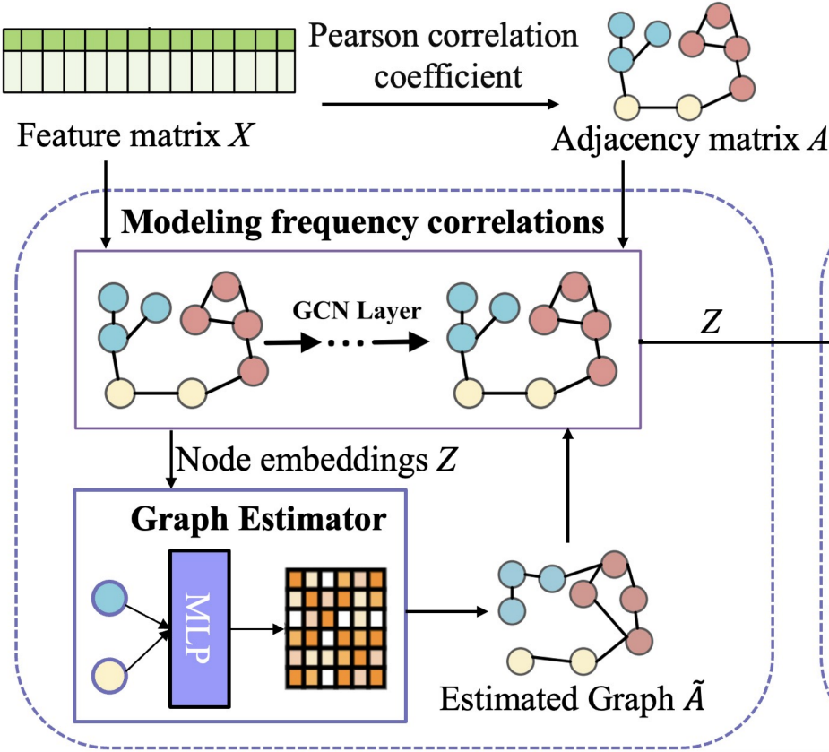
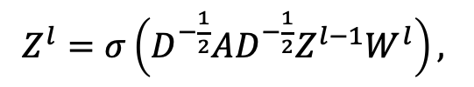
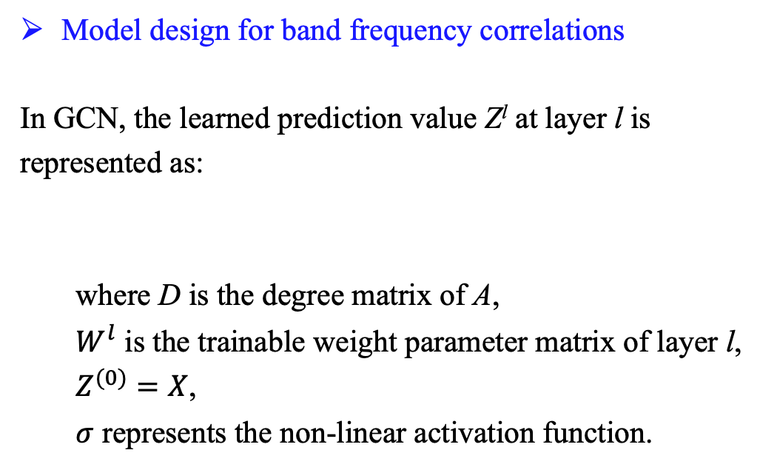
Graph convolutional network for frequency correlation
Model design for band frequency correlations
In GCN, the learned prediction value Z^{l} at layer l is represented as:
where D is the degree matrix of A,
$W^{l}$ is the trainable weight parameter matrix of layer l,
$Z^{(0)}=X$,
$σ$ represents the non-linear activation function.
$Z^{l}=σ\left(D^{−\frac{1}{2}}AD^{−\frac{1}{2}}Z^{l−1}W^{l}\right),$
9

Slide 11
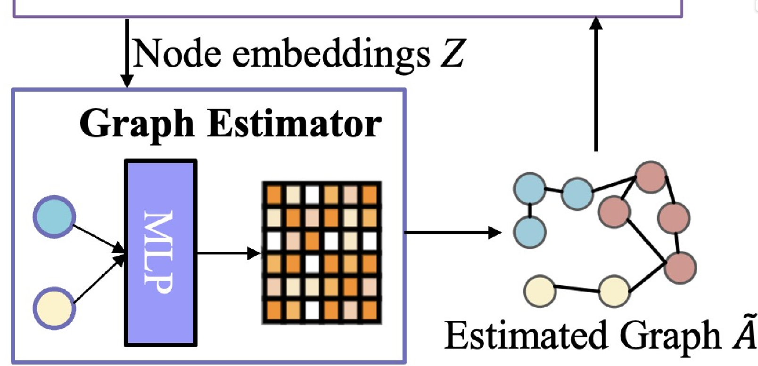
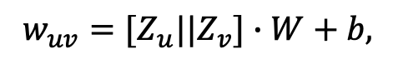
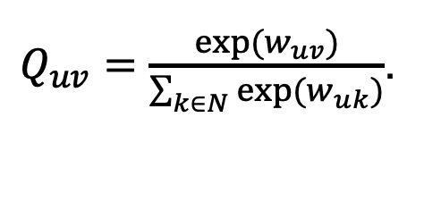
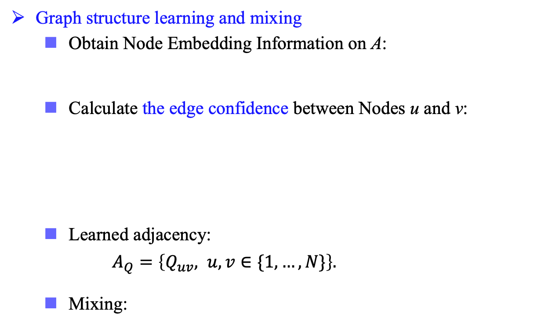
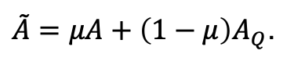
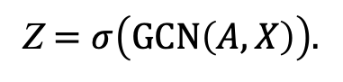
Graph estimator for graph structure learning
Graph structure learning and mixing
Obtain Node Embedding Information on A:
Calculate the edge confidence between Nodes u and v:
Learned adjacency:
$A_{Q}=\left\{Q_{uv}, u,v∈\{1,…,N\}\right\}.$
Mixing:
Z $=σ\left(GCN\left(A,X\right)\right).$
$$w_{uv}=[Z_{u}||Z_{v}]∙W+b,$$
$Q_{uv}=\frac{exp⁡(w_{uv})}{\sum_{k∈N}{exp⁡(w_{uk})}}$.
$\tilde{A}=μA+\left(1−μ\right)A_{Q}$.
10

Slide 12
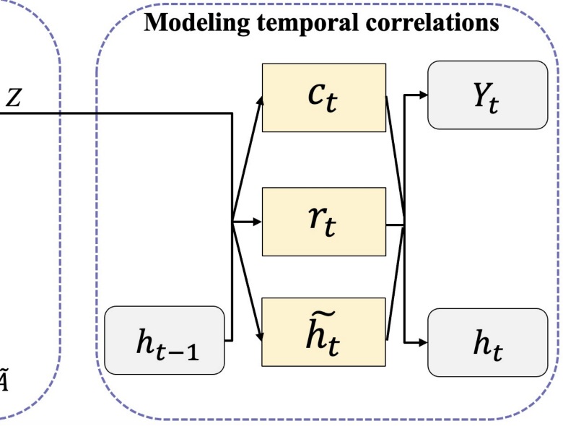

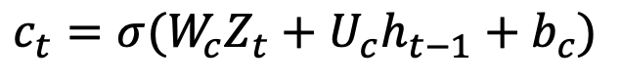
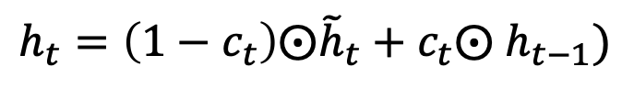
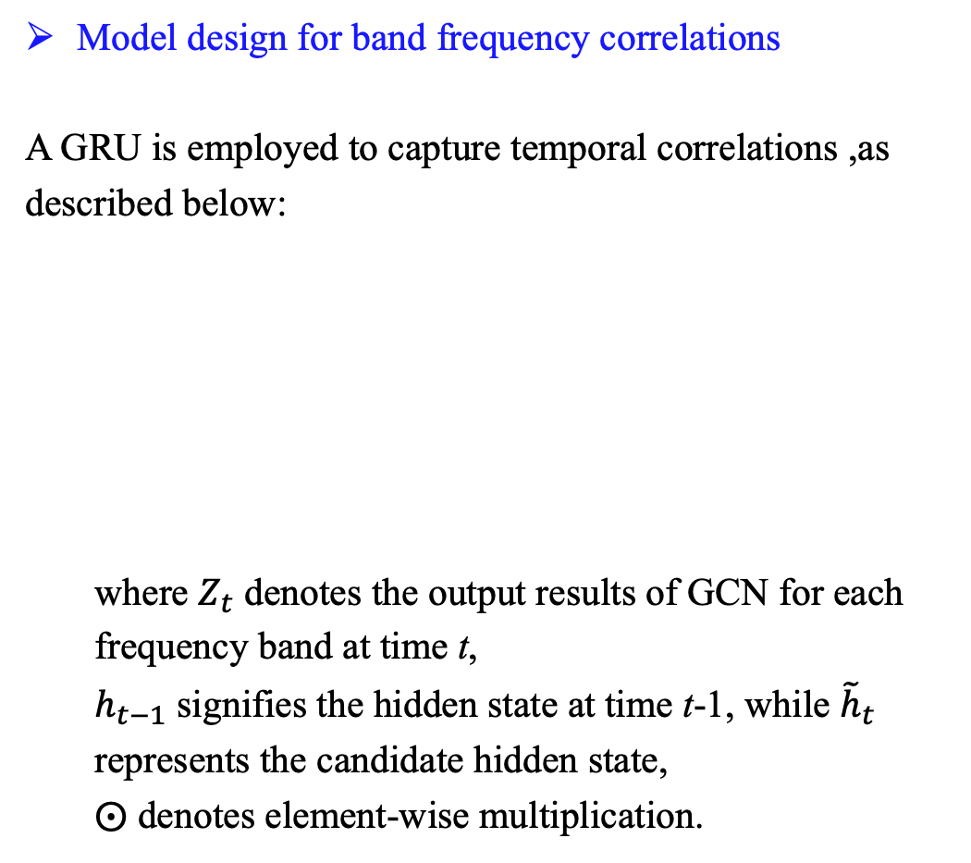
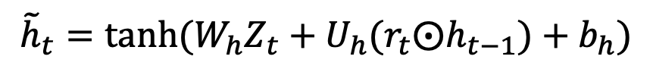
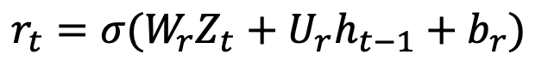
Gated recurrent unit for temporal correlation
Model design for band frequency correlations
A GRU is employed to capture temporal correlations ,as described below:
where $Z_{t}$ denotes the output results of GCN for each frequency band at time t,
$h_{t−1}$ signifies the hidden state at time t-1, while ${\tilde{h}}_{t}$ represents the candidate hidden state,
$⨀$ denotes element-wise multiplication.
$$c_{t}=σ(W_{c}Z_{t}+U_{c}h_{t−1}+b_{c})$$
$$r_{t}=σ(W_{r}Z_{t}+U_{r}h_{t−1}+b_{r})$$
$${\tilde{h}}_{t}=tanh(W_{h}Z_{t}+U_{h}(r_{t}⨀h_{t−1})+b_{h})$$
$$h_{t}=\left(1−c_{t}\right)⨀{\tilde{h}}_{t}+c_{t}⨀ h_{t−1})$$
11

Slide 13
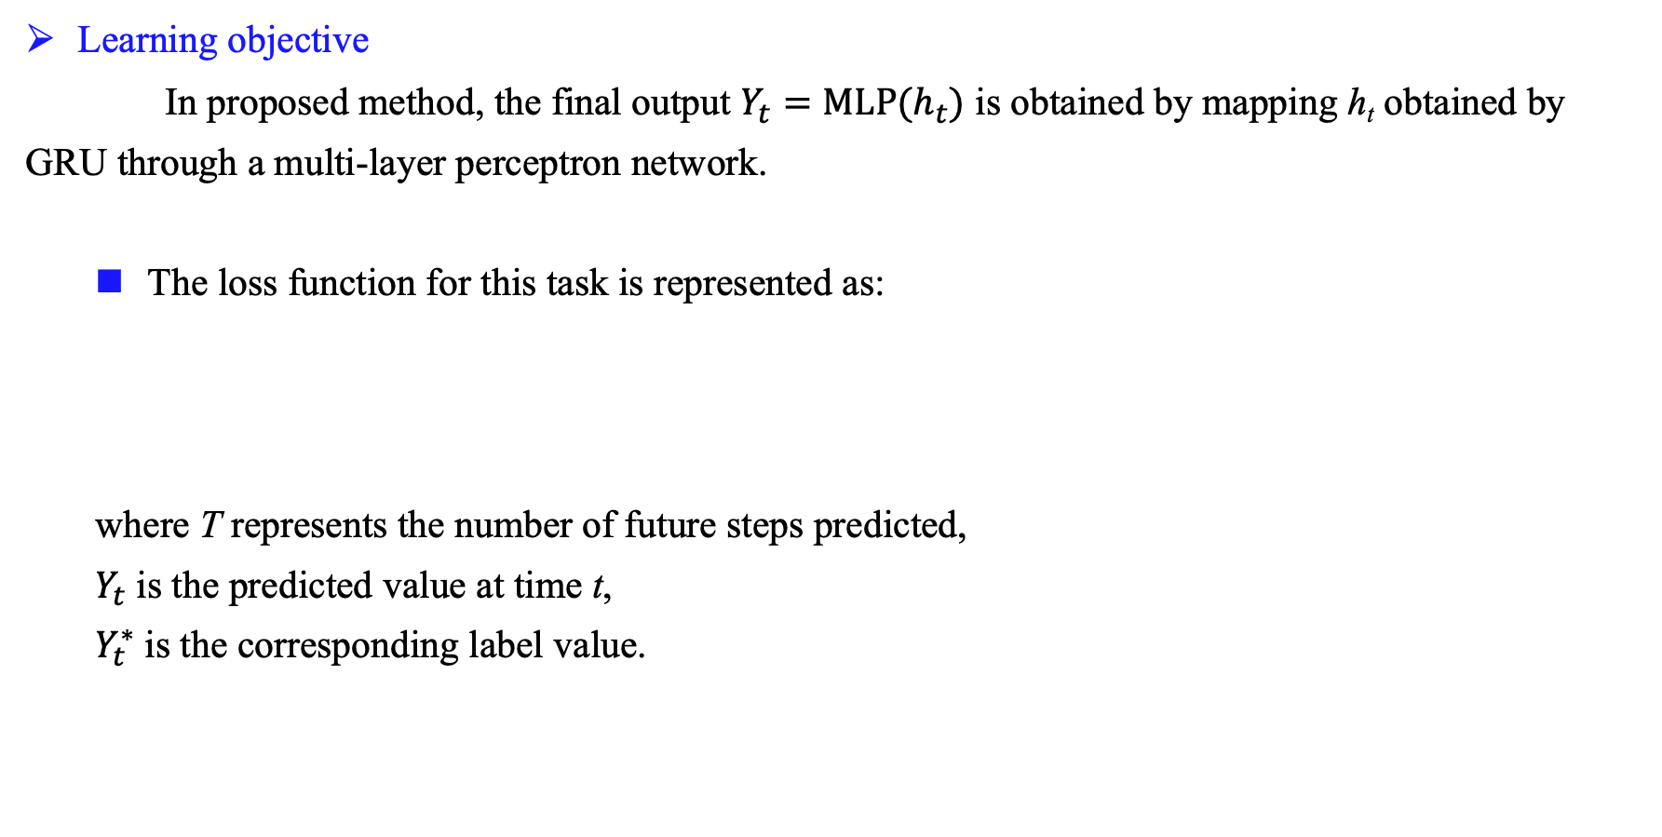
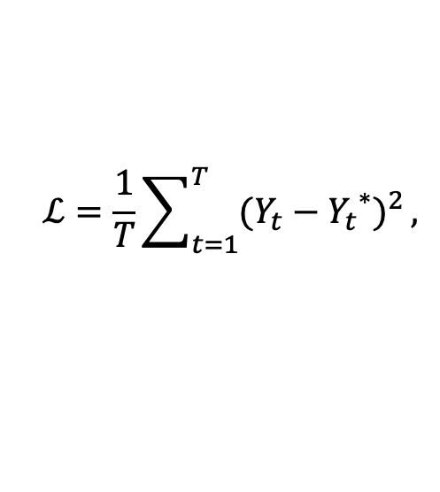
Loss function
Learning objective
In proposed method, the final output $Y_{t}=MLP(h_{t})$ is obtained by mapping h_{t} obtained by GRU through a multi-layer perceptron network.
The loss function for this task is represented as:
where T represents the number of future steps predicted,
$Y_{t}$ is the predicted value at time t,
$Y_{t}^{∗}$ is the corresponding label value.
$$ℒ=\frac{1}{T}\sum_{t=1}^{T}{{(Y_{t}−{Y_{t}}^{∗})}^{2}},$$
12

Slide 14
Simulation results - Datasets
Dataset | Spectrum measurement data of ElectroSense¹
Data type | Received signal power in dBm
Location | Madrid, Spain
Number of sensors | test_yago, bcn_L, test_rpi4, rack_2
Resolution time interval | 1 mins
Time span | 1st Jun. 2021 – 8th Jun. 2021
Frequency span | 600 – 700 MHz
Resolution bandwidth | 2 MHz
¹Electrosense open API https://electrosense.org/.
Rajendran S, Calvo-Palomino R, Fuchs M, et al. Electrosense: Open and big spectrum data[J]. IEEE Communications Magazine, 2017, 56(1): 210-217.
13

Slide 15
Simulation setups
Dataset split ratio | 8:2 (train: test)
Time step | 16 (minutes)
Prediction step | 1 (minutes)
Batch size | 32
The number of hidden layer | 64
Maximum epoches | 3000
Early stop | 32 (epoches)
Learning rate | 0.0001
14

Slide 16
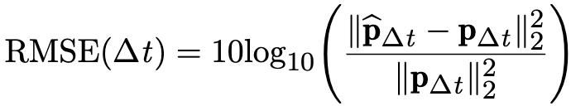
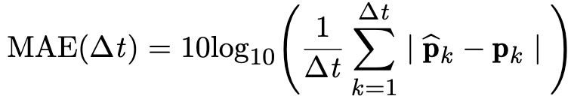
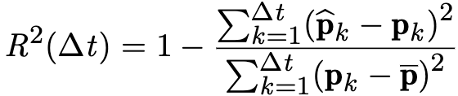
Simulation Metrics
The normalized root mean square error (RMSE):
where $\hat{P}∆t$ (i.e $\hat{P}∆t$ =[ $\hat{P}1$, ... ,̂$\hat{P}∆t$ ]) and $P∆t$ (i.e., $P∆t$ = [$P1$,..., $P∆t$ ]) are true spectrum data and predicted values in the $∆t$range, respectively.
mean absolute error (MAE):
goodness-of-fit performance (R²):
15

Slide 17
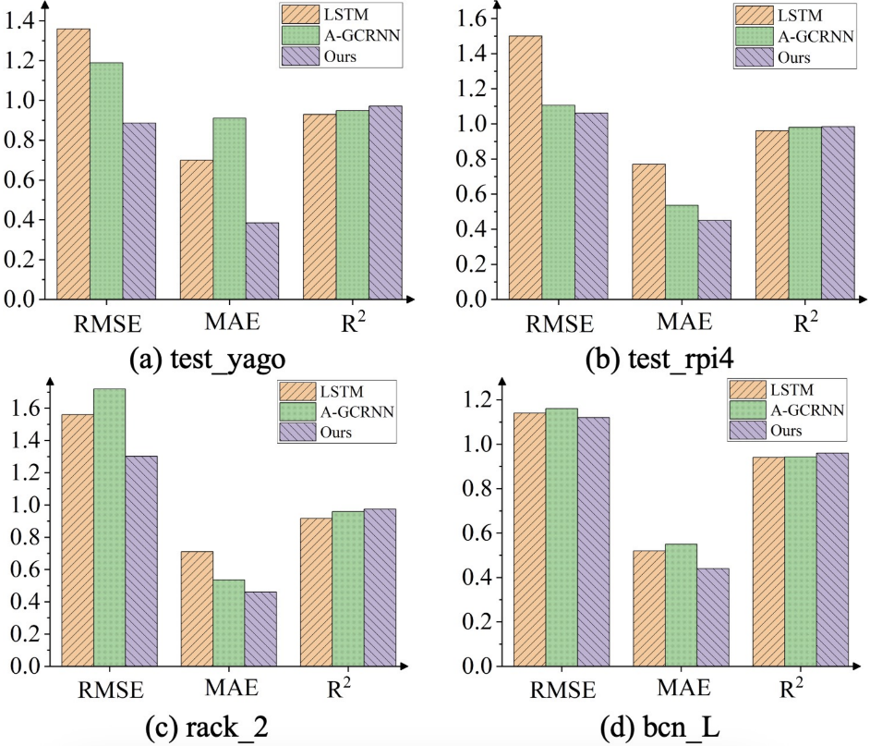
Simulation results
The prediction results of ours and other baseline methods
16

Slide 18
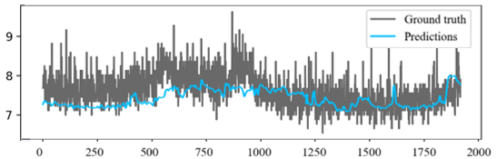
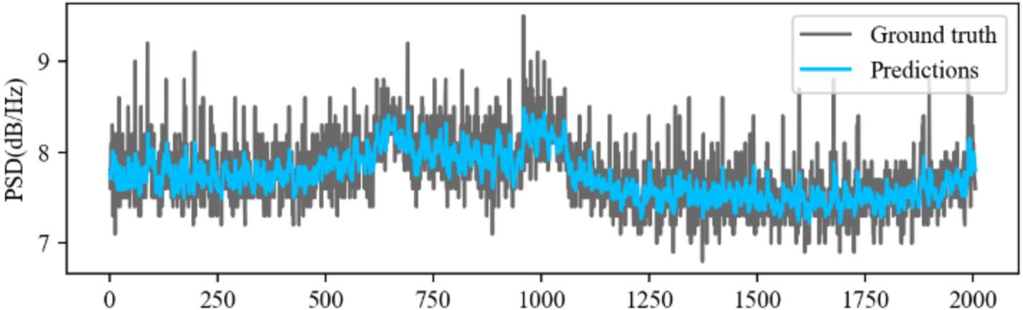

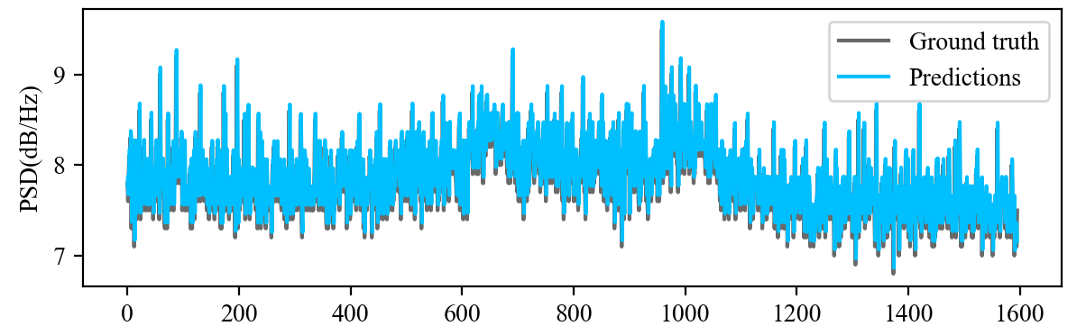

Simulation results - Visualization
Visualization of test set prediction results on test_rpi4 dataset for LSTM, A-GCRNN, and Our Model
PSD(dB/Hz)
PSD(dB/Hz)
Time/ 1 min
Time/ 1 min
(a) LSTM
(b) A-GCRNN
PSD(dB/Hz)
Time/ 1 min
(c) Ours
17

Slide 19
Concluding Remarks
We investigate the spectrum prediction task based on graphs, and propose a new framework called GSL-GCRNN which includes a graph structure estimator to dynamically learn multi-band correlations across different time periods.
In doing so, the frequency band correlations are extracted by a GCN, and then GRU is employed to capture the temporal correlations within each frequency band.
Our work is the first to successfully implement graph structure learning and is expected to bring new insights into the domain of wideband spectrum prediction.
18

Slide 20
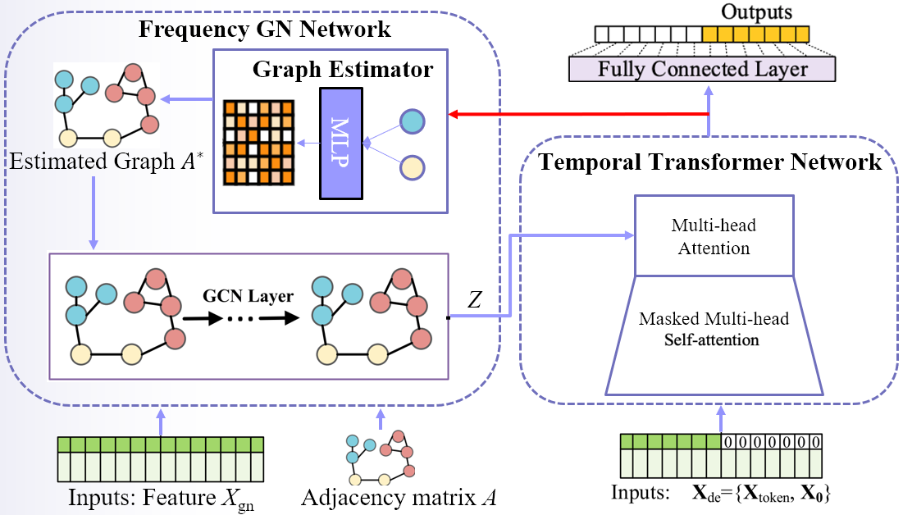

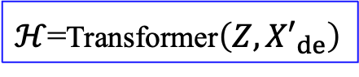
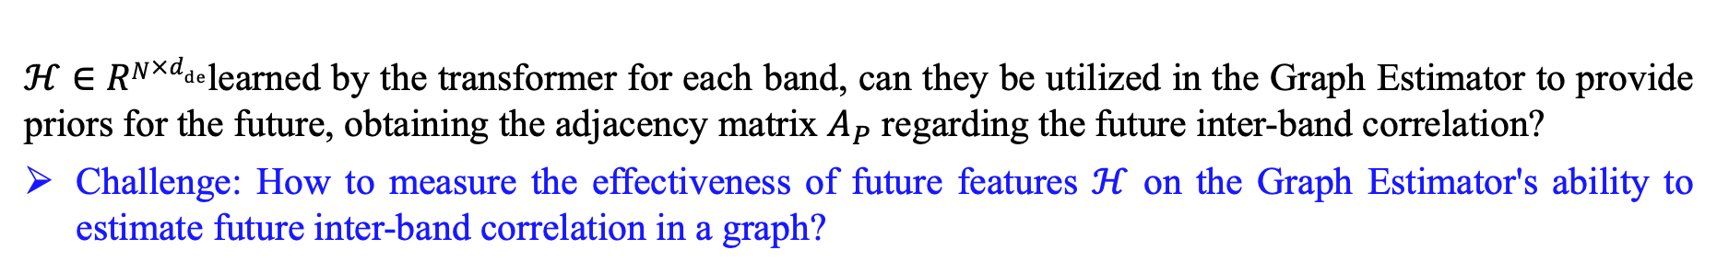








Future work
$ℋ∈RN×d_{de}$learned by the transformer for each band, can they be utilized in the Graph Estimator to provide priors for the future, obtaining the adjacency matrix $A_{P}$ regarding the future inter-band correlation?
Challenge: How to measure the effectiveness of future features $ℋ$ on the Graph Estimator's ability to estimate future inter-band correlation in a graph?
Output: Y
Attention mechanism
Y=FCL$\left(ℋ\right)$
$ℋ$=Transformer$\left(Z,{X′}_{de}\right)$
Position Embedding
$$\tilde{A}$$
Z=GCN-Encoder$\left(\tilde{A},X\right)$
Input: X_{de}
$$\tilde{A} =μA+\left(1−μ\right)A_{P}$$
$A_{P}$=Graph-Estimator$\left(A,X\right)$
X= $α_{1}∙\text{X}\text{gn}$+ $α_{2}∙ℋ$
${(α}_{1},α_{2})=$Attention-Layer(X_{gn} ,$ℋ$)
A
Input: X_{gn}, A, $ℋ$₀
19

Slide 21

Thanks!
20

